Slide 1

Correctness, Immutability, and Test Design
A Case Study with WAL High-Reliability Integration Testing
Software Testing in the AI Era
Why Test WAL and Snapshot?
Test Scenario Design & Code Implementation

Slide 2
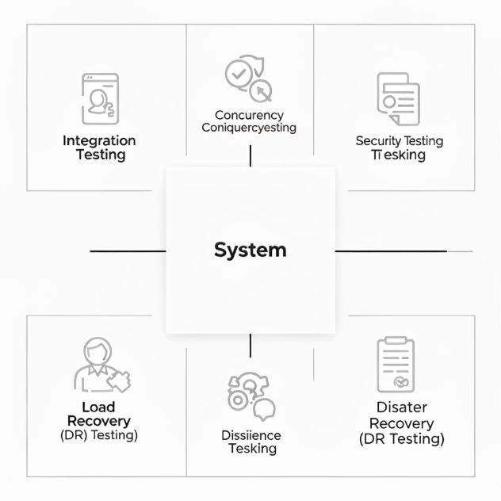
Core Competencies for Engineers in the AI Era
Complex Scenario Design
Ability to design for correctness and immutability
Engineering for Determinism & Immutability
Test Design Capability
High-quality verification and test design
Test Design & Verification Capability
Test Automation Ecosystem
Integration Testing
Concurrency Testing
Security Testing
Load Testing
Resilience Testing
Disaster Recovery (DR) Testing

Slide 3

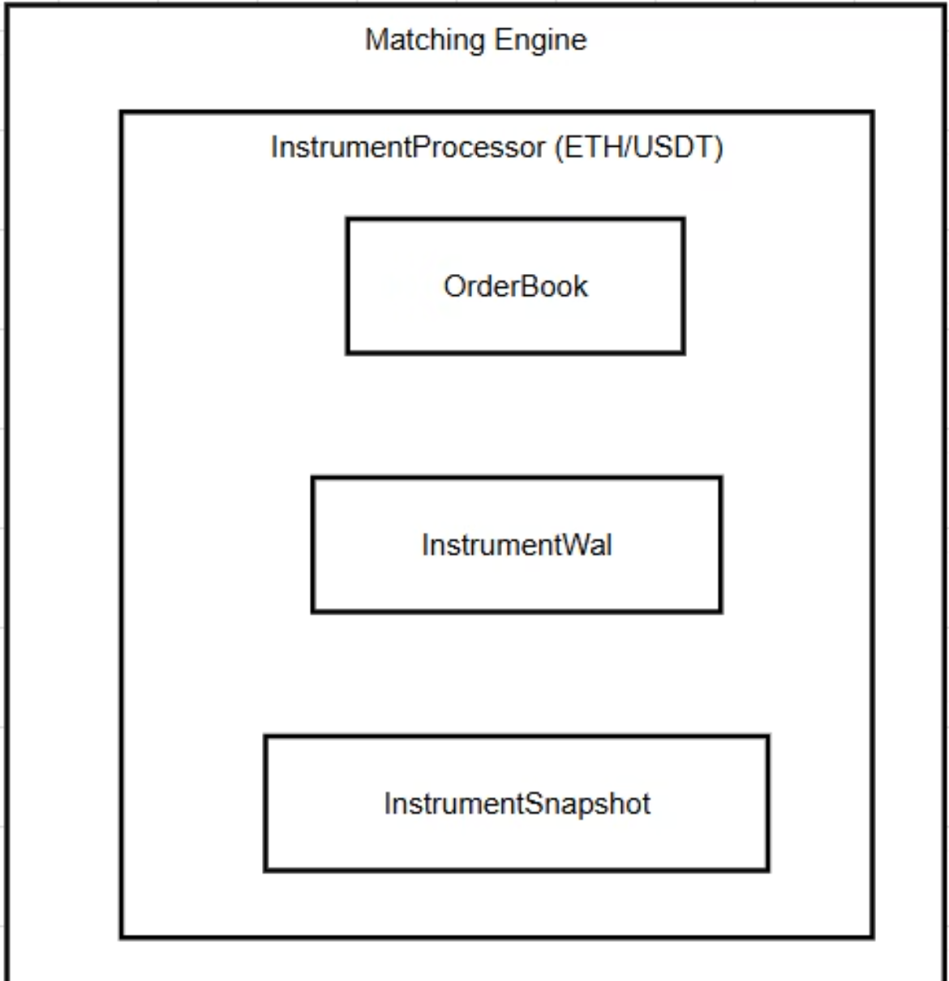
Why Test WAL and Snapshot?
Testing Objectives
RPO = 0
RTO < Seconds
Test Scope
InstrumentProcessor
OrderBook
InstrumentWal
InstrumentSnapshot

Slide 4
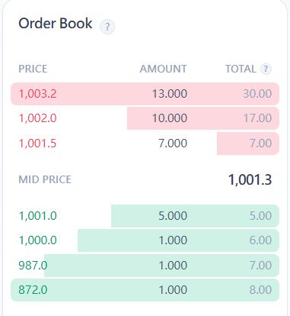
Test Scenario Design
Phase 1: Normal Operation
Write 1000 orders to trigger Snapshot, then write 2 WAL orders covering buy/sell and boundary values
Phase 2: System Crash
Simulate forced shutdown() to test recovery capability from abnormal termination
Phase 3: System Recovery
New Processor init() initialization, load Snapshot first then replay WAL to fully recover state
Phase 4: Verification Results
Verify 1002 order states, idempotency, and correctness of new business matching

Slide 5
Idempotency
Liveness
Repeated processing of WAL Log should keep system state unchanged
System can normally process new orders after recovery

Slide 6
Test Completeness Checklist
Data Persistence
Idempotency
All order data completely saved to WAL and Snapshot
Repeated processing of same WAL Log does not change system state
Disaster Recovery
Matching Logic Continuity
System can quickly recover to latest consistent state after crash
New orders can correctly match with historical orders after recovery
Numerical Precision
High-precision floating-point operations and boundary value handling are correct

